Slide 1

WEATHER FORECAST MACHINE LEARNING
Dicky Gemma Jacky Kary
Notes:
1) Business Question
2) Data Collection
3) Preprocessing
4) Model(s) Creation
5) Model Evaluation and Comparison
6) Conclusion and Future Improvements

Slide 2

01
02
03
04
05
06
BUSINESS QUESTION
DATA COLLECTION
PREPROCESSING
MODELS CREATION & COMPARISON
MODELS EVALUATION
CONCLUSION & FUTURE IMPROVEMENTS
Notes:
1) Business Question
2) Data Collection
3) Preprocessing
4) Model(s) Creation
5) Model Evaluation and Comparison
6) Conclusion and Future Improvements

Slide 3



BUSINESS VALUE
01
Find the most important features in predicting the chance of rain
Compare rainfall predictors across Northern (HK) and Southern Hemisphere (Australia)
Raise the public awareness

Slide 4



DATA COLLECTION
02
Australia Weather
2008-2017
Australian Government
( Bureau of Meteorology )
Hong Kong Weather
2000-2019

Slide 5
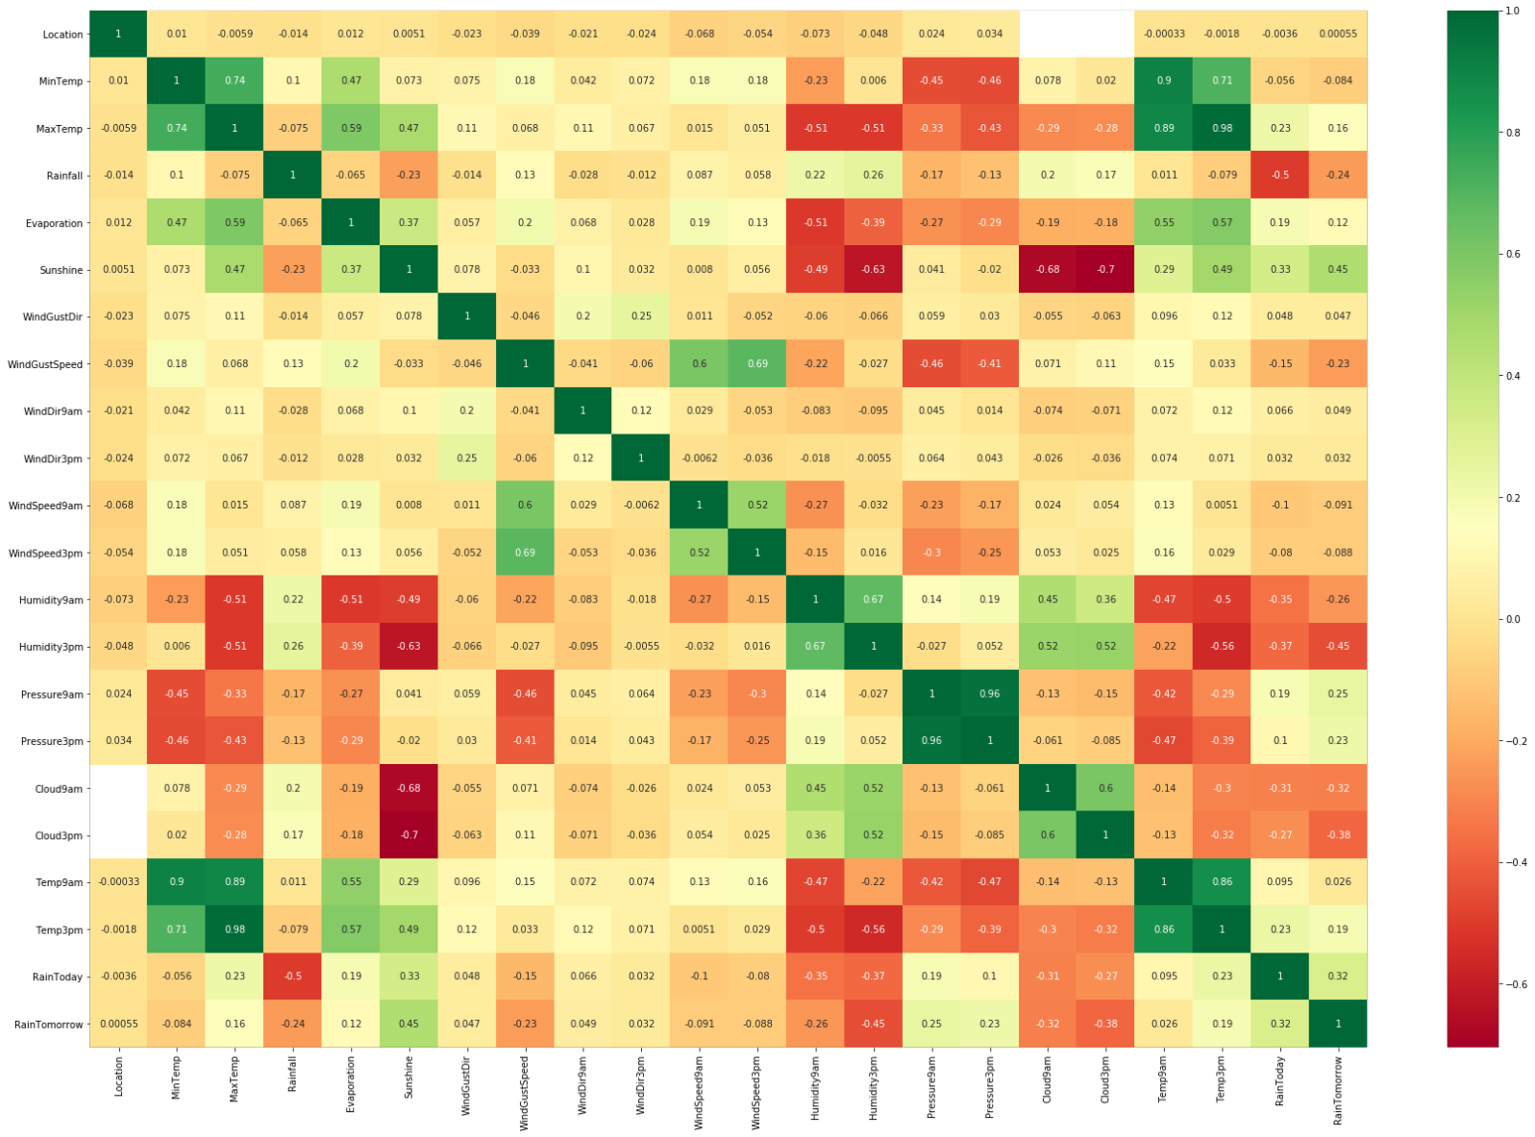

Slide 6
PREPROCESSING
03
Drop Risk_MM
Impute
Missing Values
One Hot Encoding
Drop All the
Categorical columns
Filter Common Columns
For both dataset
Split train
& test data
Remove
Outlier
Feature
Scaling

Slide 7
04
MODELS CREATION & COMPARISON
84%
82%
77%
77%
XGBoost
Random
Forest
Ada Boost
Linear
Regression
76%
76%
75%
72%
Logistic
Regression
Decision
Tree
SVM
KNN
Notes:
1) Business Question
2) Data Collection
3) Preprocessing
4) Model(s) Creation
5) Model Evaluation and Comparison
6) Conclusion and Future Improvements

Slide 8
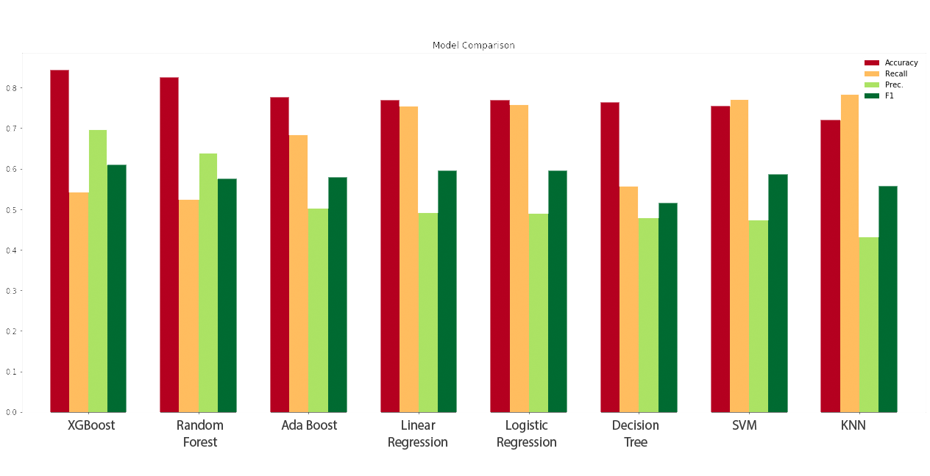

MODELS COMPARISON

Slide 9
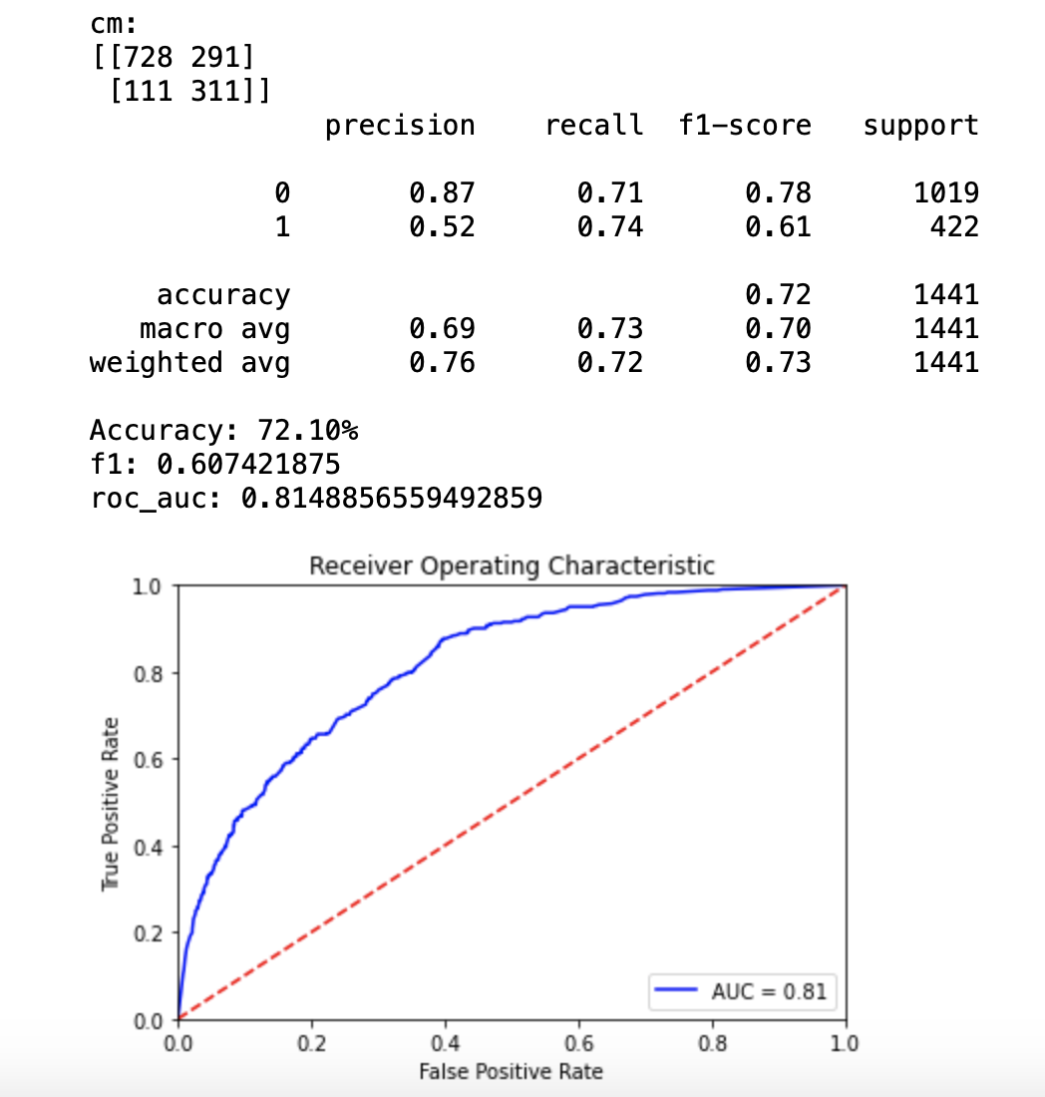
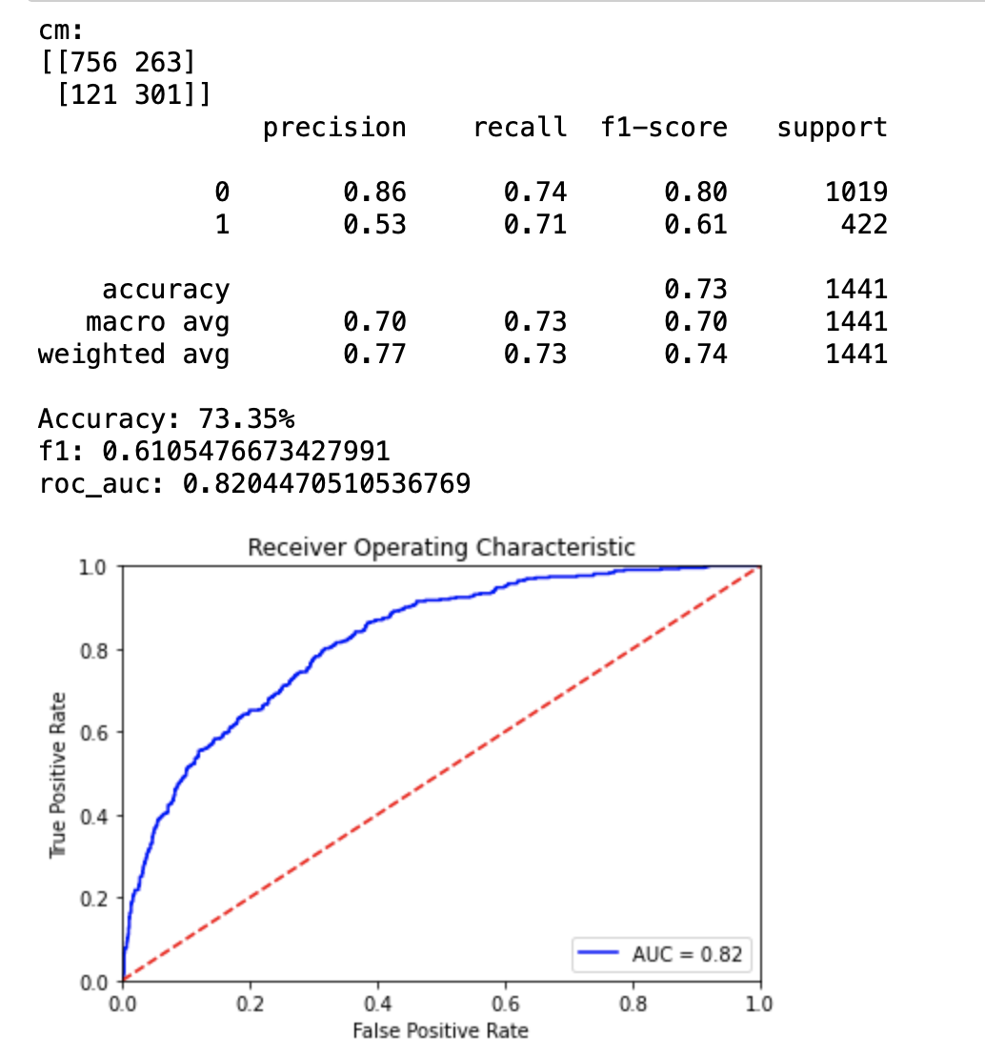
MODEL EVALUATION
05
VS
XGBoost
Random Forest

Slide 10
CONCLUSION
06
84%
82%
~75%
XGBoost
Random
Forest
Other
Models

Slide 11
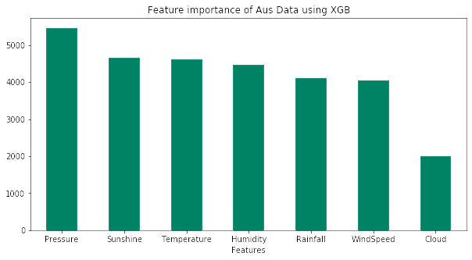
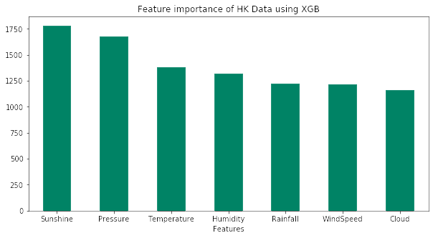
CONCLUSION
Top 3 features: Pressure, Sunshine, Temperature
Notes:
1) Business Question
2) Data Collection
3) Preprocessing
4) Model(s) Creation
5) Model Evaluation and Comparison
6) Conclusion and Future Improvements

Slide 12

CONCLUSION & FUTURE IMPROVEMENT
Season isn’t an important feature
Focus on top three features : Pressure, Temperature, Sunshine
Feature engineering: feature cross with date/month column
Quantitative Prediction: rainfall (mm)

Slide 13
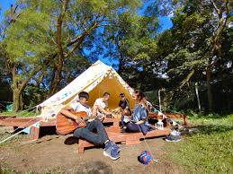
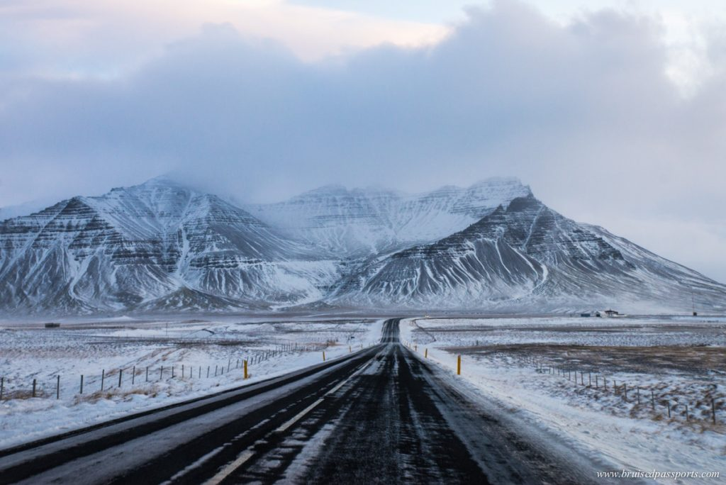

SCENARIO WITH PREDICTION
 | Hong Kong Camping | Iceland Road Trip | Volunteer in Bethlehem
Pressure (hPa) | 1013 | 1007 | 1016
Temperature (°C) | 29.1 | 11.2 | 22.7
Humidity (%) | 69 | 80 | 75
Cloud (%) | 18 | 81 | 25
Sunshine (hour) | 6.2 | 2.4 | 9.8
Windspeed (km/hr) | 6 | 3.1 | 12.2
Rainfall (mm) | 2 | 3 | 0
Rain Probability | 0.11 | 0.76 | 0.01
Rain? | No | Yes | No
Notes:
1) Business Question
2) Data Collection
3) Preprocessing
4) Model(s) Creation
5) Model Evaluation and Comparison
6) Conclusion and Future Improvements

Slide 14

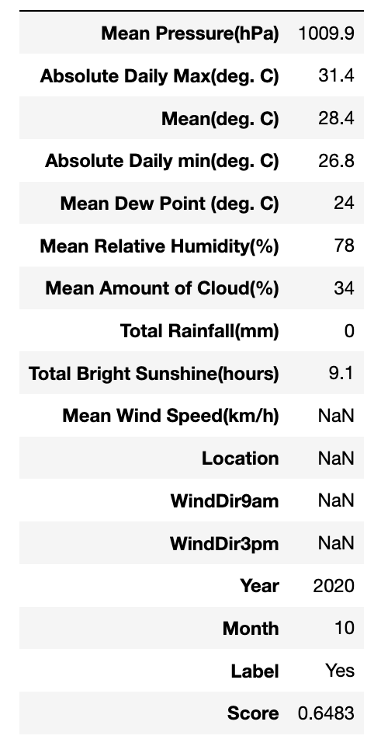
PREDICTING TODAY’S CHANCE OF RAINING!
4/10
HK WEATHER
Notes:
1) Business Question
2) Data Collection
3) Preprocessing
4) Model(s) Creation
5) Model Evaluation and Comparison
6) Conclusion and Future Improvements

Slide 15

Q&A

